Slide 1

Time Series Analysis of COVID-19 for the United States and North Carolina
Brandon Croom
Notes:
The human and business impact of the COVID-19 pandemic continues to unfold globally.
The rapid pace at which the pandemic is spreading is having an unprecedented impact on the way we live and do business.
While it is too early to fully understand the impact of these events, the goal of this project will be to analyze what the future in might look like in the post pandemic world.
This analysis will hopefully assist Gov. Roy Cooper and Dr. Mandy Cohen (NCDHHS head)

Slide 2

Positivity Rate
Percentage of all coronavirus tests performed that are positive
High values indicate high infection rate or low testing rate
Low values indicate low level of transmission
Point in time based metric
Notes:
Beginning the analysis, evaluating the positivity rate a metric that is often cited in discussions of the state of the pandemic and in pandemic policy making. The positivity rate is defined as the percentage of all coronavirus tests performed that are positive.
Positivity rate is a point in time-based metric. Thus a location can go from high to low (or low to high) depending upon virus transmission or testing availability.
This metric can be someone confusing to individuals as a high value indicates a higher infection rate (or lower rate of testing) while a low value indicates the level of transmission, relative to testing, is low at this point in time.
Reference: https://www.jhsph.edu/covid-19/articles/covid-19-testing-understanding-the-percent-positive.html#:~:text=The%20percent%20positive%20is%20exactly,total%20tests)%20x%20100%25.
Given the velocity with which the pandemic and data reporting has been changing over the course of the pandemic, a point in time metric such as this is probably the best way to make decisions. Continued education to individuals when discussing this metric is required. This metric is not as simple to understand as a metric such as active cases or deaths.

Slide 3
Data Set Information
COVID19.analytics R-Package
John Hopkins University – data source
Minimal missing data
Focus will be on “Active” cases
Notes:
The COVID19 data was sourced leveraging the COVID19.analytics package. This package aggregated global COVID19 data sources as well as COVID19 genome information. For US specific information, the John Hopkins University dataset that has been prevalent in many COVID19 discussions. This dataset is relatively clean missing data that needed to be addressed. From the data set can obtain, total confirmed cases, deaths, recovered and active cases, as well as an indicent_rate and case_fataility ratio. The data covers up to 11/20/2020 and will continually be updated.

Slide 4
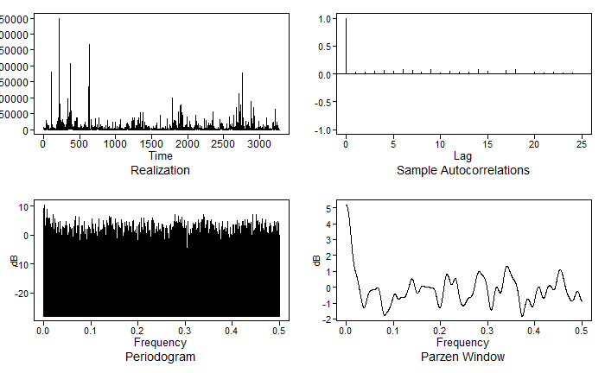
United States Analysis
Notes:
Evaluating the US data, the realization (in the upper left) shows how active cases have progressed over time. There is not any noticeable wandering or cyclic behavior in the data that can be visually inferred from this plot. For this analysis, the data is assumed to be stationary
The ACF plot (upper right) – seems to indicate slowly damping cyclic patterns. Again visually it’s difficult to determine
The spectral density plot (lower right) – indicates a large peak at zero as well as other smaller peaks thoughout the display. This could possibility indicate a seasonal trend, however there is not enough data at this time to confirm

Slide 5

United States ARMA Model
Determined ARMA(1,3) model, shown below, was best fit
AIC: 18.83
BIC: 18.84
$\left(1−0.9573B\right)\left(X_{t}−3,561.395\right)=\left(1−0.9454B −0.0009B^{2}+0.3379B^{3}\right)$ $a_{t}$
where $σ_{a }^{2}=150,065,620$
Notes:
In order to build the model, estimates for the AR and MA components from both AIC and BIC were leveraged. This approach assists in finding a less complex model if possible. Both AIC and BIC selected ARMA models with p=1 and q=3. The appropriateness of this model was further verified through residual evaluation both visually and through the Ljung-Box test. In both cases, the residuals indicated white noise.

Slide 6
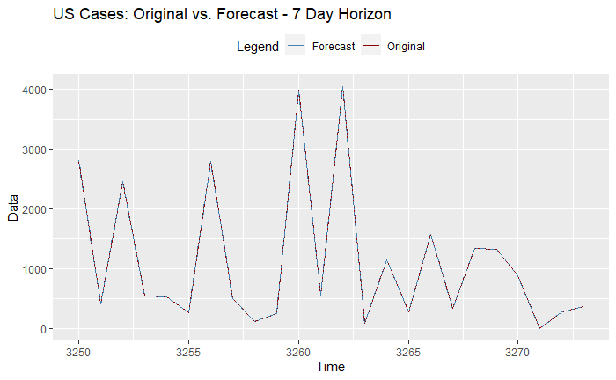
United States 7-Day Forecast
Mean Windowed ASE: 156,542,492
Notes:
The 7-day forecast for the US, given the size is difficult to view. Here we have blow into the last 25 observations so show the original and the forecast executions. From this graph we see that the forecast seems to be tracking well at this level. In evaluating this forecast, the ASE metric is used, specifically the rolling window ASE. Leveraging a rolling window ASE provides a view of the data at intervals vs a point in time view. In this particular case, the Mean Windowed ASE is: 156542492.52

Slide 7

United States 90-Day Forecast
Mean Windowed ASE: 157,754,919
Notes:
The 90-day forecast for the US, given the size is difficult to view. Here we have blow into the last 25 observations so show the original and the forecast executions. From this graph we see that the forecast seems to be tracking well at this level. In evaluating this forecast, the ASE metric is used, specifically the rolling window ASE. Leveraging a rolling window ASE provides a view of the data at intervals vs a point in time view. In this particular case, the Mean Windowed ASE is: 157754919.96

Slide 8
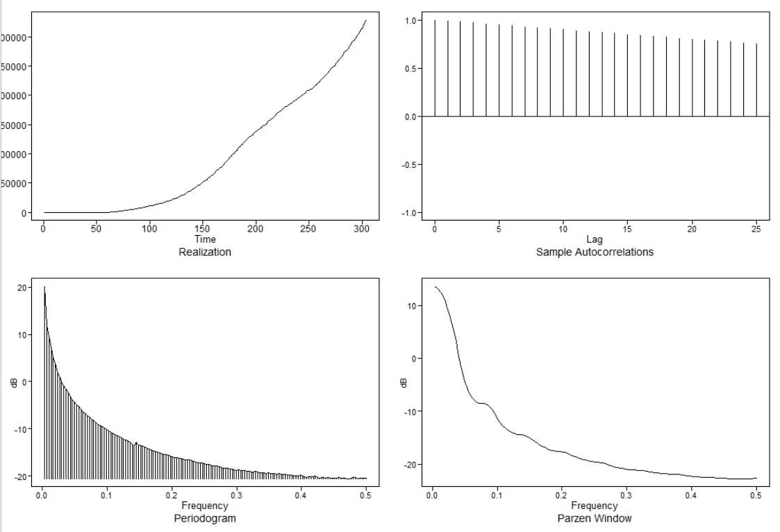
North Carolina Analysis
Notes:
Evaluating the North Carolina data, the realization (in the upper left) shows how active cases have progressed over time. There is almost an exponential growth trend to the curve. Indications of wandering are not present.
The ACF plot (in the upper right) appear to be slowly damping, but there is very little trend apparent in the visual
The spectral density plot (lower right) – indicates a large peak at approximately 0 and then it tails off consistently.
All of these indicators point to non-stationarity in the data. In order to

Slide 9

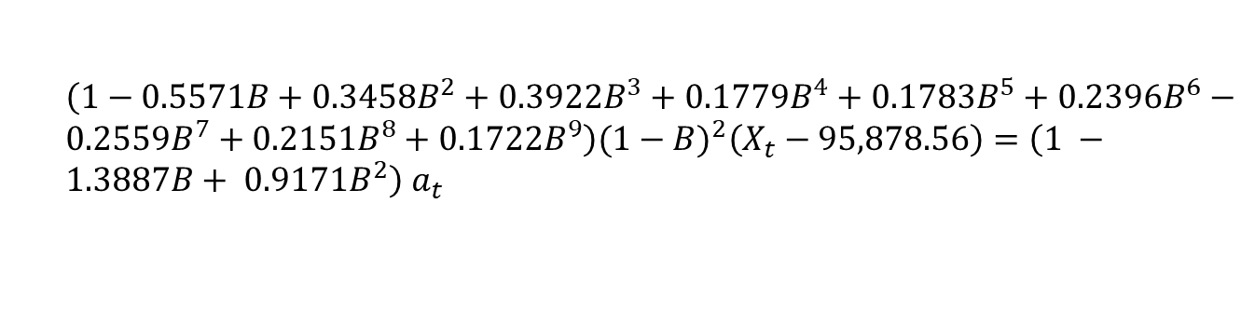
North Carolina ARIMA Model
Determined ARIMA(9,2,2) model, shown below, was best fit
AIC: 11.17
BIC: 11.32
$\left(1−0.5571B+0.3458B^{2}+0.3922B^{3}+0.1779B^{4}+0.1783B^{5}+0.2396B^{6}−0.2559B^{7}+0.2151B^{8}+0.1722B^{9}\right)(1−B)^{2}\left(X_{t}−95,878.56\right)=\left(1 −1.3887B+ 0.9171B^{2}\right)$ $a_{t}$
where $σ_{a }^{2}=65,915.42$
Notes:
After differencing the data twice, model estimates for the AR and MA components from both AIC and BIC were leveraged. Both AIC and BIC selected ARMA models with p=9 and q=2. The appropriateness of this model was further verified through residual evaluation both visually and through the Ljung-Box test. In both cases, the residuals indicated white noise. This indicates that the model should be appropriate.

Slide 10
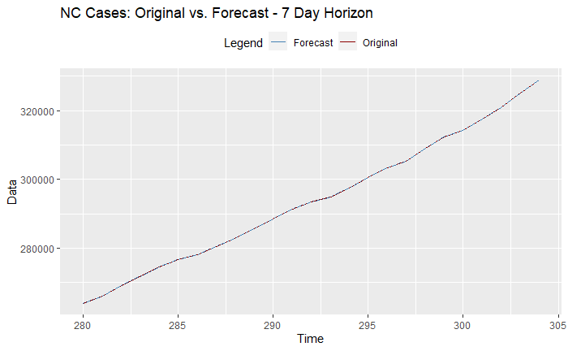
North Carolina 7-Day Forecast
Mean Windowed ASE: 132,167,366
Notes:
The 7-day forecast for North Carolina, given the size is difficult to view. Here we have blow into the last 25 observations so show the original and the forecast executions. From this graph we see that the forecast seems to be tracking well at this level. In evaluating this forecast, the ASE metric is used, specifically the rolling window ASE. Leveraging a rolling window ASE provides a view of the data at intervals vs a point in time view. In this particular case, the Mean Windowed ASE is: 132167366.101864

Slide 11
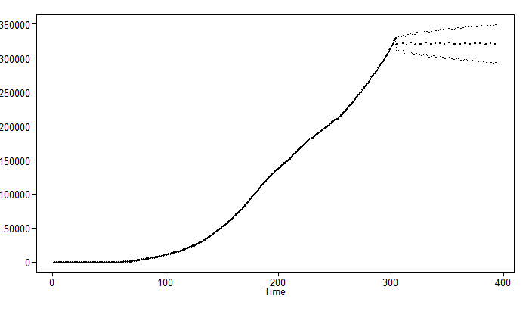
North Carolina 90-Day Forecast
Mean Windowed ASE: 26,135,810
Notes:
The 90-day forecast for North Carolina, is viewable. As can be seen from the plot above the 90-day forecast simply levels out toward the mean of the data. As with the previous forecasts, the ASE metric is used, specifically the rolling window ASE. In this case, the Mean Windowed ASE is: 26,135,810.588992

Slide 12
Future Direction
Further refine the ARMA/ARIMA models
Leverage Deep Learning algorithms
Begin to include external variables
Comparison of models for possible future usage
Notes:
As this analysis continues to progress, further refinement of the ARMA/ARIMA models will be needed. The models presented here are a first pass and additional work may be performed to ensure the are fit for use.
Additionally, the growth of deep learning in time series modeling will be an approach that can also be leveraged for this analysis. The model analysis can also be expanded by leveraging external variables. In this current analysis, the focus was only on the single value of active cases, expanding to include other factors (for example: hospital capacity, PPE availability, or testing information) may assist in firming up the modeling forecasts. Finally, the forecasting ability of these models will be compared. This will provide an indication of future direction for these model use cases.

Slide 13
Thank You.

